Slide 1
Data Communication and
Networks

Slide 2
OSI Model

Slide 3
Overview
Introduction
OSI Model
Layer interface
Interfaces between layers
Design Issues of layers
Importance of Layering
Organization of layers
Layers of OSI Model

Slide 4


Evolution of networking standards
SNA
Standard
Interconnection
Development
Simplification
TCP/IP
DECNET

Slide 5

OSI model
Researched and developed by the ISO - International Organization for Standardization.
1977: establish a subcommittee to develop a communications architecture.
1984: publish ISO-7498, the Open System Interconnection (OSI) reference model.

Slide 6

OSI model
The OSI model: a framework within which networking standards can be developed.
  It provided vendors with a set of standards that ensured greater compatibility and interoperability between the various types of network technologies that were produced by the many companies around the world.
Proprietary vs. Open

Slide 7
OSI model
OSI model consists of seven separate but related layers.
Seven layers are designed such that the functionality of each layer is serviced to the other layers.
Each layer defines a segment of the process moving information across a network.
Data to be transmitted from one system to another has to pass the seven layers of its own OSI model.

Slide 8
OSI Model
Layer given in the OSI generally communicates with three other OSI layers.
    Layer directly above
    Layer directly below
    Peer layer is other networked systems.

Slide 9
Layer interface
Layering is a common form of abstraction that is used to reduce the apparent complexity of large applications.
It is a variant of the traditional divide-and-conquer approach.
Complex functionality is dissected into a progression of layers each of which can be understood independent of the layers above and with minimal knowledge of the layers below.
Layering is strictly hierarchical relationship.

Slide 10
Importance of Layering
Three important advantages:
    It allows a complex problem broken into smaller, and more manageable prices.
    Specification of layers says nothing about its implementation; implementations details of a layer are hidden from other layers.
    Many upper layers can share the services provided by the lower layer.

Slide 11
Design Issues of layers
Connection establishment: Each layer must have a mechanism for connection establishment.
Data Transfer: The rules of data transfer are to be defined
Error Control:
    Physical communication circuits are not perfect.
    Many error- detecting and error correcting codes are possible.
    Both ends must accept the error detection mechanism.

Slide 12
Order of the messages: To deal with the possible loss of sequencing the protocol must make explicit provision for the receiver to allow the pieces to be put back together properly.
Long messages: The inability of all processes to accept arbitrarily long messages is to be addressed.
Routing: when there are multiple paths between source and destination a shortest route must be chosen.

Slide 13
OSI Layer Services
3 basic elements are involved in layer services.
  Service user: OSI layer request services from an adjacent layer
  Service provider: OSI layer provide services to an adjacent layer.
  Service Access points (SAP): Interface between the lower and upper layer is called (SAP).

Slide 14
Standardization of OSI framework
Provide frame work for standardization
  One or more protocol standards can be developed at each layer
  Functions of each layer are well defined.
  Standards can be developed independently and simultaneously for each layer.
  Boundaries between layers are well defined changes in standards in one layer need not affect already existing software in another layer thus enabling new standards to be created.
  Nature of standardization required at each layer

Slide 15
Protocol Specification
  Two entities at the same layer in different systems cooperate and interact by means of a protocol.
  Two different open systems are involved the protocol must be specified precisely.
  Format of the protocol data units exchanged, the semantics of all fields and the allowable sequence of PDUs

Slide 16
Service Definition:
  Standards are needed for the service that each layer provided to the next higher layer.
  Definition of services is equivalent to a functional description that defines what services are provided but not how the services are to be provided.

Slide 17
Addressing
  Each layer provides services to entities at the next higher layer.
  These entities are referenced by means of a service access point (SAP).
  Network service access point (NSAP) indicates a transport entity that is a user of the network service.

Slide 18
Service primitives
  The services between adjacent layers in the OSI architecture are expressed in terms of primitives.
  Primitives specifies the function to be performed.
  Parameter is used to pass data and control information.
  The actual form of a primitive is implementation-dependent
  Four types of primitive are used in standards (X.210)

Slide 19
REQUEST
Issued by a service user to invoke some service and to pass the parameters needed to fully specify the requested service
INDICATION
Issued by a service provider to either indicate that a procedure has been invoked by the peer service user on the connection and to provide the associated parameters or notify the service user of a provider-initiated action
RESPONSE
Issued by a service user to acknowledge or complete some procedure previously invoked by an indication to that user
CONFIRM
Issued by a service provider to acknowledge or compete some procedure previously invoked by a request by the service user

Slide 20
Organization of OSI layers
  The seven layers can be thought of as belonging to three sub groups
  Network support layers
    Layers 1,2,3 (physical, Data link and network layers) belong to this group
    They deal with the physical aspects of moving data from one device to another
  Transport layer
    Layer 4 belongs to this group
    This ensures reliable end-to-end data transmission

Slide 21
User Support Layers
  Layers 5,6,7 belong to this group
  They allow interoperability among unrelated software systems

Slide 22
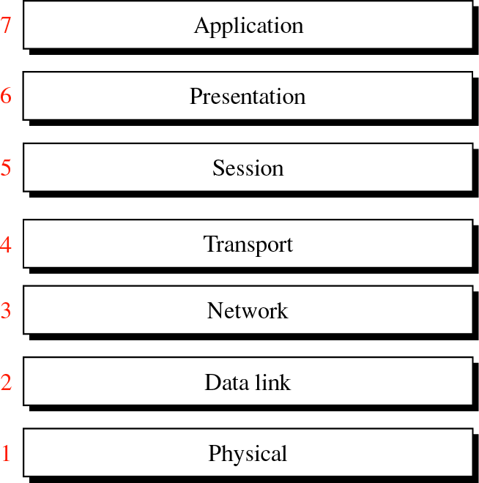
Figure 2-1

Slide 23
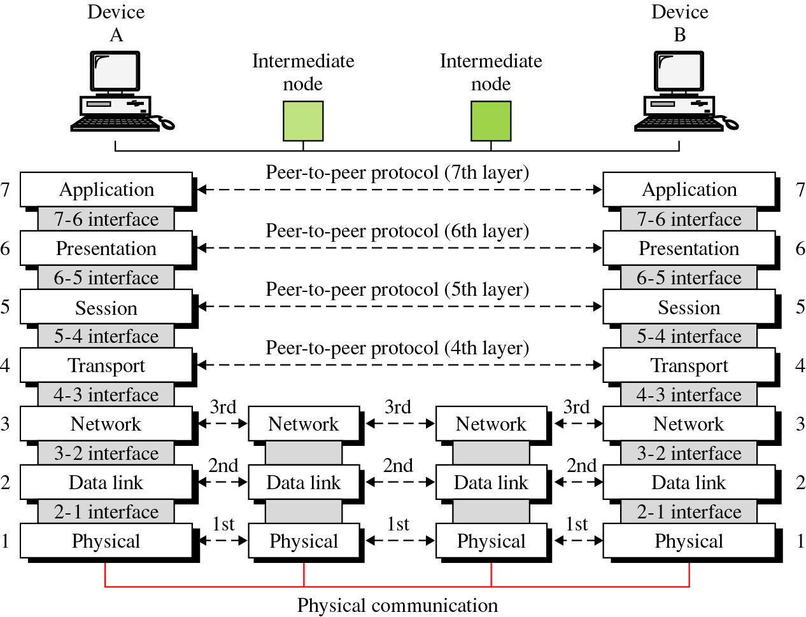
Figure 2-2

Slide 24
Physical Layer: Responsibilities
  This is the lowest of the seven layers in OSI stack.
  It Concerned with transmitting raw bits over a communication channel
  Deals with the mechanical and electrical specifications of the interface and transmission medium

Slide 25
Mechanical: Defines the physical attributes of the connector, such as number of pins, shape and dimensions of the connecting block etc
Electrical: Specifies whether the connection is balanced or unbalanced and what voltages are to be used.
Functional: Defines which electrical circuit performs what function such as data control timing etc.

Slide 26
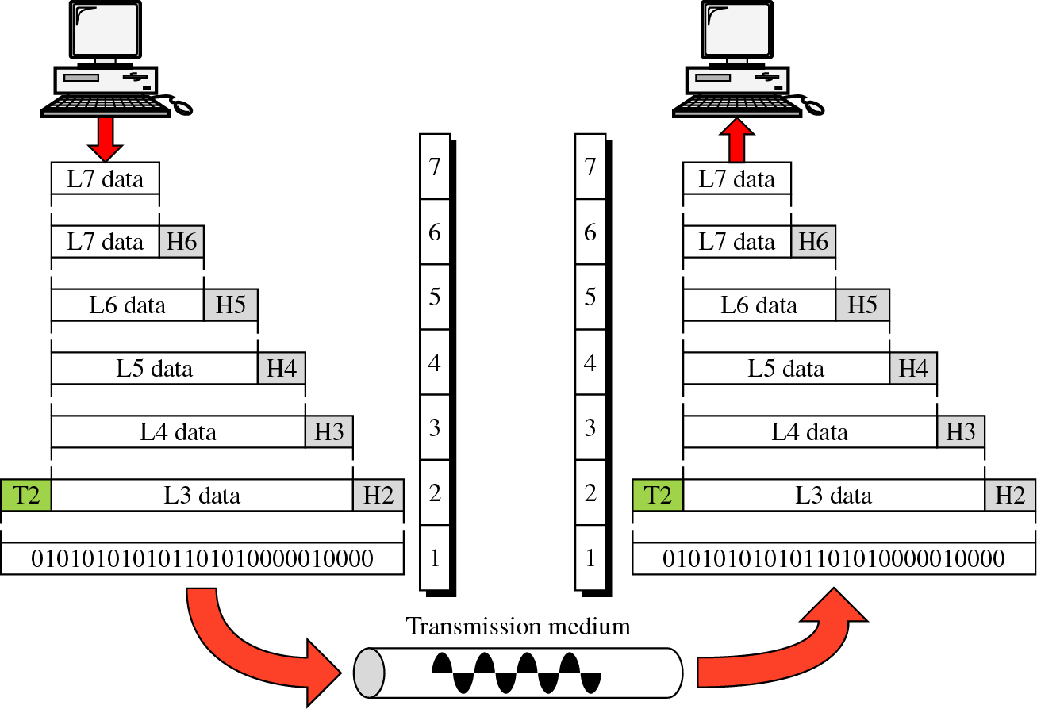
Figure 2-3

Slide 27
Physical Layer:(contd..)
Defines the procedures and functions that physical devices and interfaces have to perform for transmission to occur.
Representation of Bits:
  The physical layer data consists of a stream of bits which cannot be interpreted.
  Bits must be encoded into signals electrical or optical.
  Defines the type of encoding.

Slide 28
Physical Layer:(contd..)
  Data Rate: The transmission rate is defined by physical layer. (The number of bits sent per second)
  Synchronization of bits: The sender and receiver must be synchronized at the bit level through the clock

Slide 29
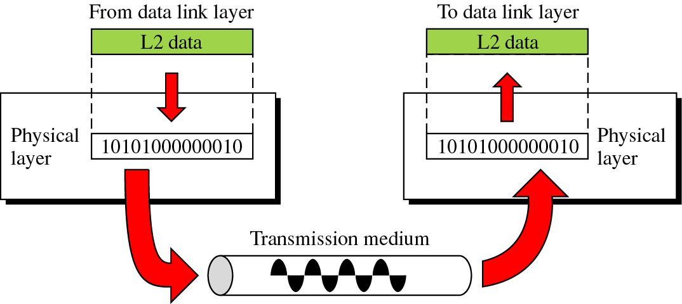
Figure 2-4

Slide 30
Physical Layer:(contd..)
  Line configuration: The physical layer is concerned with the connection of devices of the medium (Point to Point /Multipoint)
  Transmission mode: The physical layer defines the direction of transmission between two devices (simplex, half duplex full duplex).

Slide 31
Data Link Layer: Responsibilities
  Responsible for node-to-node validity and integrity of the transmission.
  Details and possible correct errors, which may occur.
  So this layer transform a stream of bits from physical into a data frame and provides an error-free transfer.

Slide 32
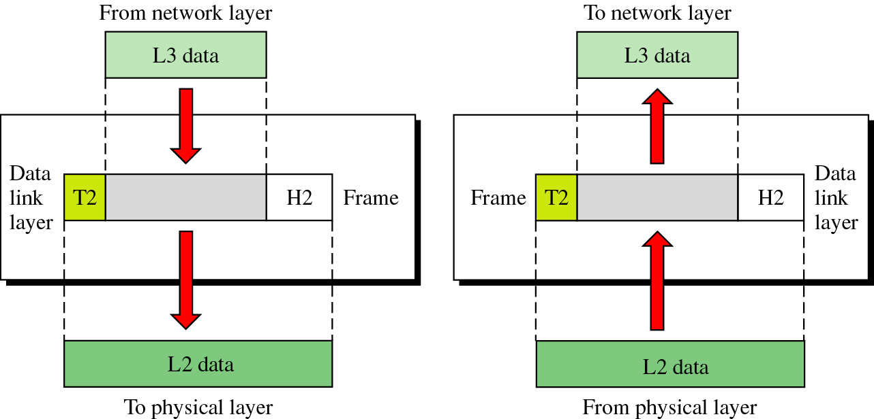
Figure 2-5

Slide 33
Data Link Layer: Responsibilities(contd..)
  Sender break the input data into frame, transmit the frames sequentially, and processes the acknowledge frames sent back by the receiver.
  The data link layer actually consists of two separate parts, the Medium access control (MAC) and the logical link control layer (LLC).
    Examples of MAC are Ethernet802.3 and Token Ring 802.5. Bridges are examples of devices that work at MAC level.

Slide 34
Data Link Layer: Responsibilities(contd..)
  Framing: The data link layer divides the stream of bits received from the network layer into manageable data units called frames.
  Physical addressing: If frames are to be distributed to different systems in a network the data link layer adds a header to the frame to define the physical address of the sender and destination address of the frame.

Slide 35
Data Link Layer: Responsibilities(contd..)
Flow Control:
  Rate at which the data are absorbed by the receiver is less than the rate produced by the sender the data link layer imposes a flow control mechanism to prevent overflow at the receiver end.
A frame looks like
Destination ID
Sender ID
Control
Data
CRC

Slide 36
Data Link Layer: Responsibilities(contd..)
• Error Control:
    The data link layer adds reliability to the physical layer by adding mechanisms to detect and retransmit damaged and lost frames.
    It also uses a mechanism to prevent duplication of frames.
    Error control is normally added through a trailer to the end of the frame
• Access control: When two or more devices are connected to the same link data link layer protocols are necessary to determine which device has control which device.

Slide 37
Network Layer: Responsibilities
  Responsible for source-to-destination delivery of a packet.
  It does not recognize any relationship between those packets.
  Controlling the operations of the subnet.
  Key design issue is how packets are routed from source to destination.

Slide 38
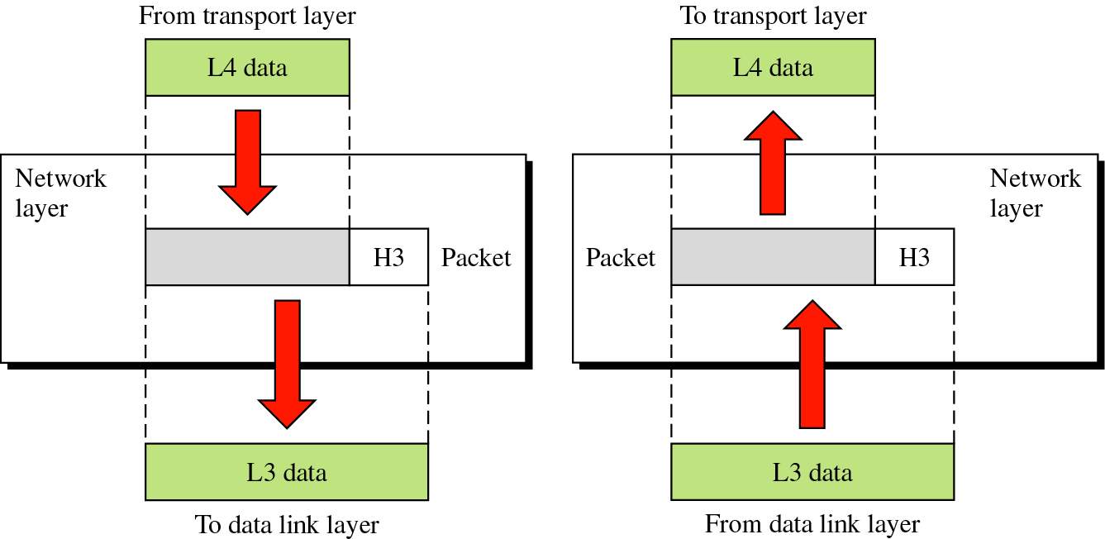
Figure 2-6

Slide 39
Network Layer: Responsibilities(contd..)
Logical addressing:
  The physical addressing implemented by the data link layer handles the addressing problem locally.
  Once it enters the network it requires a new addressing system.
  The network layer adds a header to the packet coming from the upper layer. This includes the logical address of the sender and receiver
  Routing: When independent networks or links are connected together to create a network the connecting devices route the packets to their final destinations.

Slide 40
Transport Layer: Responsibilities
  Responsible for the source-to-destination delivery of the entire message.
  Accepts data form session layer, split it into smaller units, pass these to the network layer.
  It ensures that the whole message arrives intact and in order overseeing both error control and flow control at the source to destination level.

Slide 41
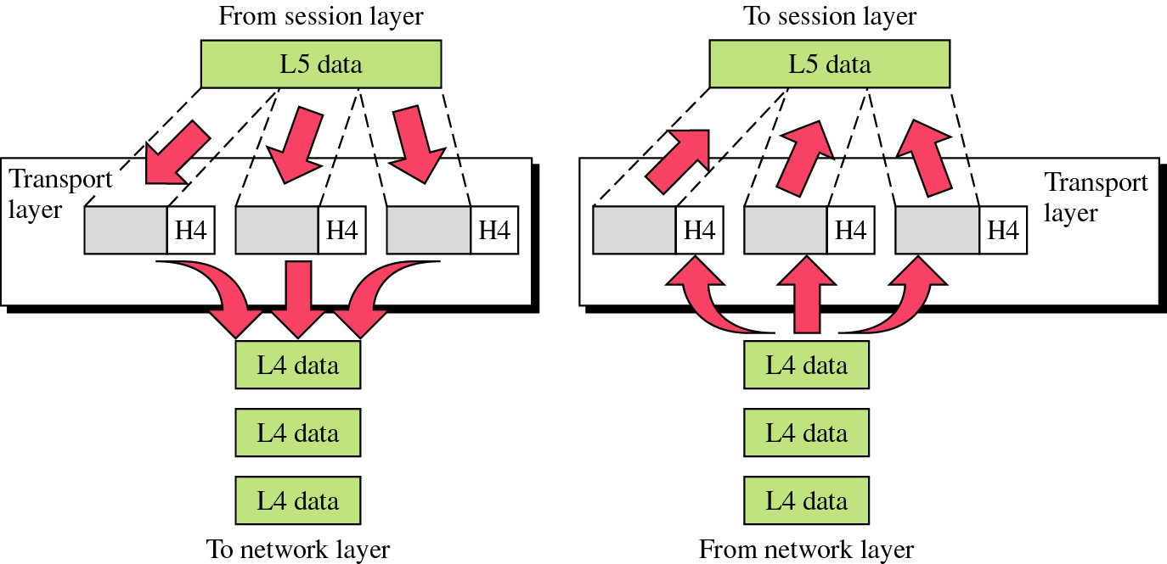
Figure 2-7

Slide 42
Transport Layer: Responsibilities(contd..)
Service-point addressing.
  Computer often runs several programs at the same time.
  The transport layer header must include a type of address called service-point address (port address).
Segmentation and reassembly:
  A message is divided into transmittable segments each segment containing a sequence number.
  These numbers enable the transport layer to reassemble the message correctly upon arriving at the destination and to identify and replace packets that were lost in transmission.

Slide 43
Transport Layer: Responsibilities(contd..)
•
Flow Control:
  Like the data layer, the transport layer is responsible for flow control.
  Flow control at this layer is performed end to end rather than across a single link
Error Control:
  Like the data link layer transport layer is also responsible for error control.
  Error control at this layer is performed end to end rather than across a single link Error control is usually achieved through retransmission

Slide 44
Transport Layer: Responsibilities(contd..)
Connection control:
  The transport layer can be either connectionless or connection oriented.
  A connectionless transport layer treats each segment as an independent packet and delivers it to the transport layer at the destination machine.
  A connection oriented transport layer makes a connection with the transport layer at the destination machine before delivering the packets.

Slide 45
Transport Layer: Responsibilities(contd..)
Transport Protocol:
  The size and complexity of a transport protocol depends on how reliable or unreliable the underlying network and network layer services are.
  ISO has developed a family of five transport protocols standards each oriented towards a different underlying standard.
  In the TCP/IP suite there are two common transport layer protocols connection oriented TCP and connectionless UDP

Slide 46
Figure 2-7

Slide 47
Session Layer: Responsibilities
  It establishes maintains, synchronizes the interaction between communicating systems.
  Also called dialog controller
Dialog control:
  This allows two systems to enter into a dialog. Allows the communication between two processes to take place either in half duplex or full duplex mode.

Slide 48
Session Layer: Responsibilities(contd..)
Synchronization:
  Allows a process to add checkpoints into a stream of data. This is called recovery mechanism.
  Any failure occurs between checkpoints the session entity can retransmit all data since the last checkpoint

Slide 49
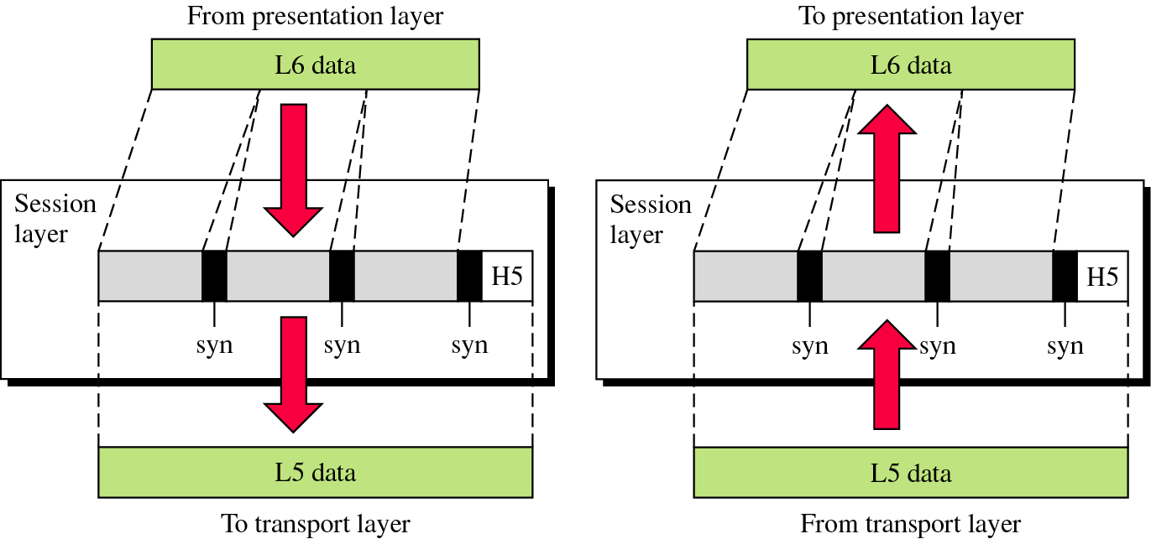
Figure 2-8

Slide 50
Presentation Layer: Responsibilities
Concerned with syntax and semantics of information exchanged between two systems
Translation:
  The processes in two systems are usually exchanging information in the form of character strings, numbers etc.
  Different computers use different encoding systems this layer is responsible for interoperability between these different encoding methods.

Slide 51
Presentation Layer: Responsibilities(contd..)
Encryption:
  To carry sensitive information a system must be able to assure privacy.
Compression:
  Data compression reduces the number of bits to be transmitted.
  Data compression becomes particularly important in the transmission of multimedia data

Slide 52
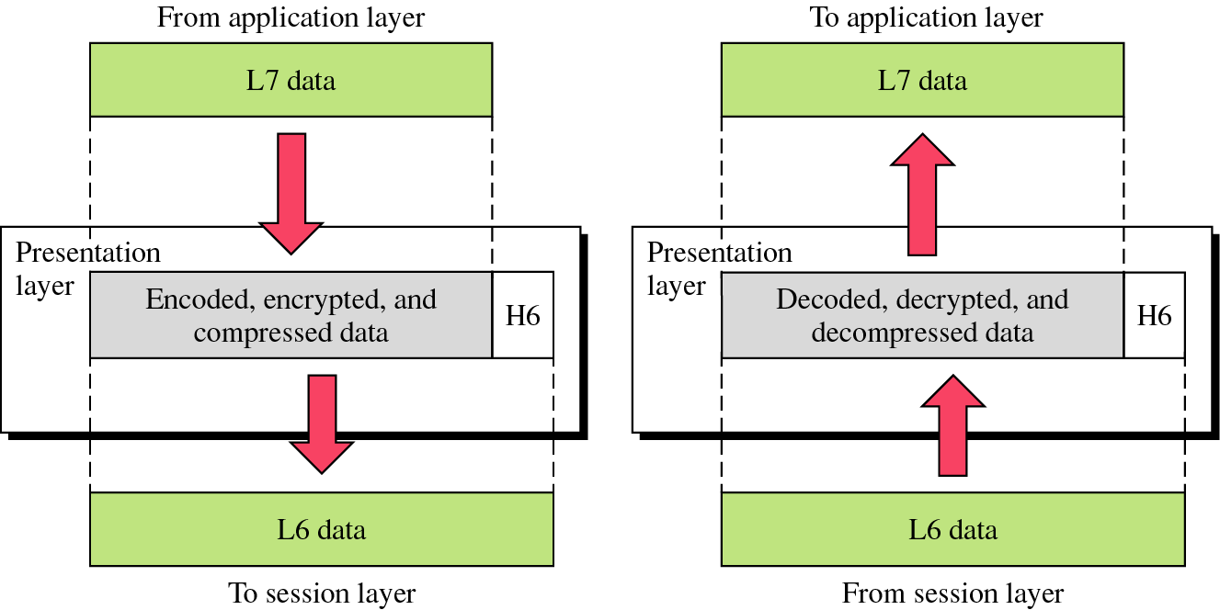
Figure 2-9

Slide 53
Application Layer: Responsibilities
  Top layer of the reference model
  It contains a variety of protocol that is commonly needed.
  It Enables a user to access the network
  Provides user interfaces and support for services such as electronic mail, remote file access and transfer shared database management and other distributed information services.

Slide 54
Application Layer: Responsibilities(contd..)
Network Virtual terminal:
  This is a software version of a physical terminal and allows a user to log on to a remote host.
File Transfer, Access and Management (FTAM):
  This allows a user to access files in a remote computer to retrieve files from a remote computer and to manage or control files in a remote computer.

Slide 55
Application Layer: Responsibilities(contd..)
Mail Services:
  This application provides the basis for email forwarding
Directory Services:
  Provides distributed database sources and access for global information about various objects and service

Slide 56
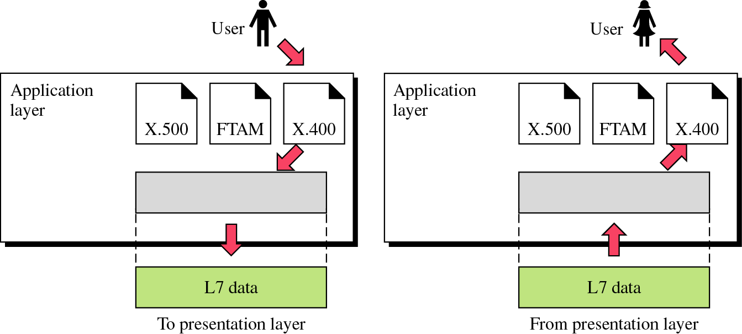
Figure 2-10

Slide 57
TCP/IP model development
The late-60s The Defense Advance Research Projects Agency (DARPA) originally developed Transmission Control Protocol/Internet Protocol (TCP/IP) to interconnect various defense department computer networks.
The Internet, an International Wide Area Network, uses TCP/IP to connect networks across the world.

Slide 58
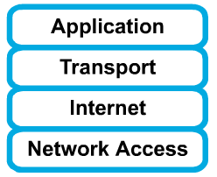
4 layers of the TCP/IP model
Layer 4: Application
Layer 3: Transport
Layer 2: Internet
Layer 1: Network access
It is important to note that some of the layers in the TCP/IP model have the same name as layers in the OSI model.
Do not confuse the layers of the two models.

Slide 59
The network access layer
Concerned with all of the issues that an IP packet requires to actually make the physical link. All the details in the OSI physical and data link layers.
  Electrical, mechanical, procedural and functional specifications.
  Data rate, Distances, Physical connector.
  Frames, physical addressing.
  Synchronization, flow control, error control.

Slide 60
The internet layer
Send source packets from any network on the internetwork and have them arrive at the destination independent of the path and networks they took to get there.
  Packets, Logical addressing.
  Internet Protocol (IP).
  Route , routing table, routing protocol.

Slide 61
The transport layer
The transport layer deals with the quality-of-service issues of reliability, flow control, and error correction.
  Segments, data stream, datagram.
  Connection oriented and connectionless.
  Transmission control protocol (TCP).
  User datagram protocol (UDP).
  End-to-end flow control.
  Error detection and recovery.

Slide 62
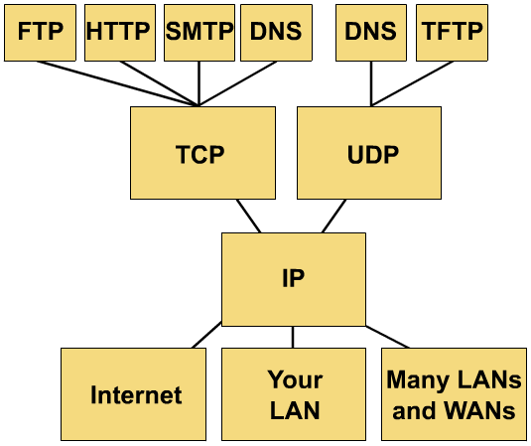
TCP/IP protocol stack
TCP/IP protocol stack

Slide 63
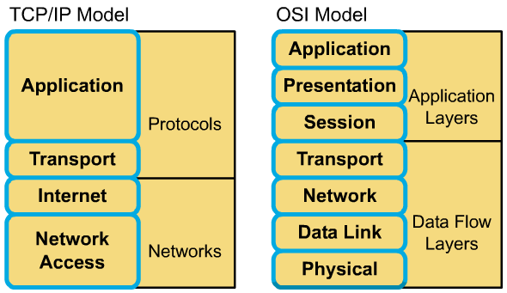
Comparing TCP/IP with OSI

Slide 64
Comparing TCP/IP with OSI (cont.)
Similarities:
  Both have layers.
  Both have application layers, though they include very different services.
  Both have comparable transport and network layers
  Packet-switched technology is assumed.
  Networking professionals need to know both.

Slide 65
Comparing TCP/IP with OSI (cont.)
Differences:
  TCP/IP combines the presentation and session layer issues into its application layer.
  TCP/IP combines the OSI data link and physical layers into one layer.
  TCP/IP appears simpler because it has fewer layers.
  Typically networks aren't built on the OSI protocol, even though the OSI model is used as a guide.

